Slide 1
Recommendation system for scientific tools and workflows
Master’s thesis
Anup Kumar
Adviser: Dr. Björn Grüning

Slide 2
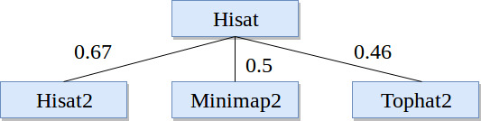
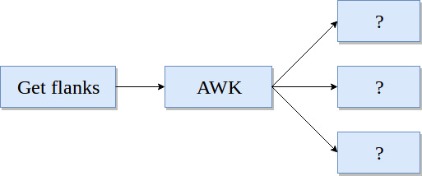
Recommendation system
Find similar scientific tools
2. Predict tools for workflows

Slide 3
Find similar scientific tools
Tools similar in functions
Compute similarity among tools
Recommend similar tools
Replace a tool by its similar tool
Provide more options for data processing

Slide 4
Approach
Collect tools metadata (~ 1,050 tools)
Clean metadata - stemming and stopwords
Learn vectors for tools
Compute similarity among vectors
Combine similarity matrices

Slide 5
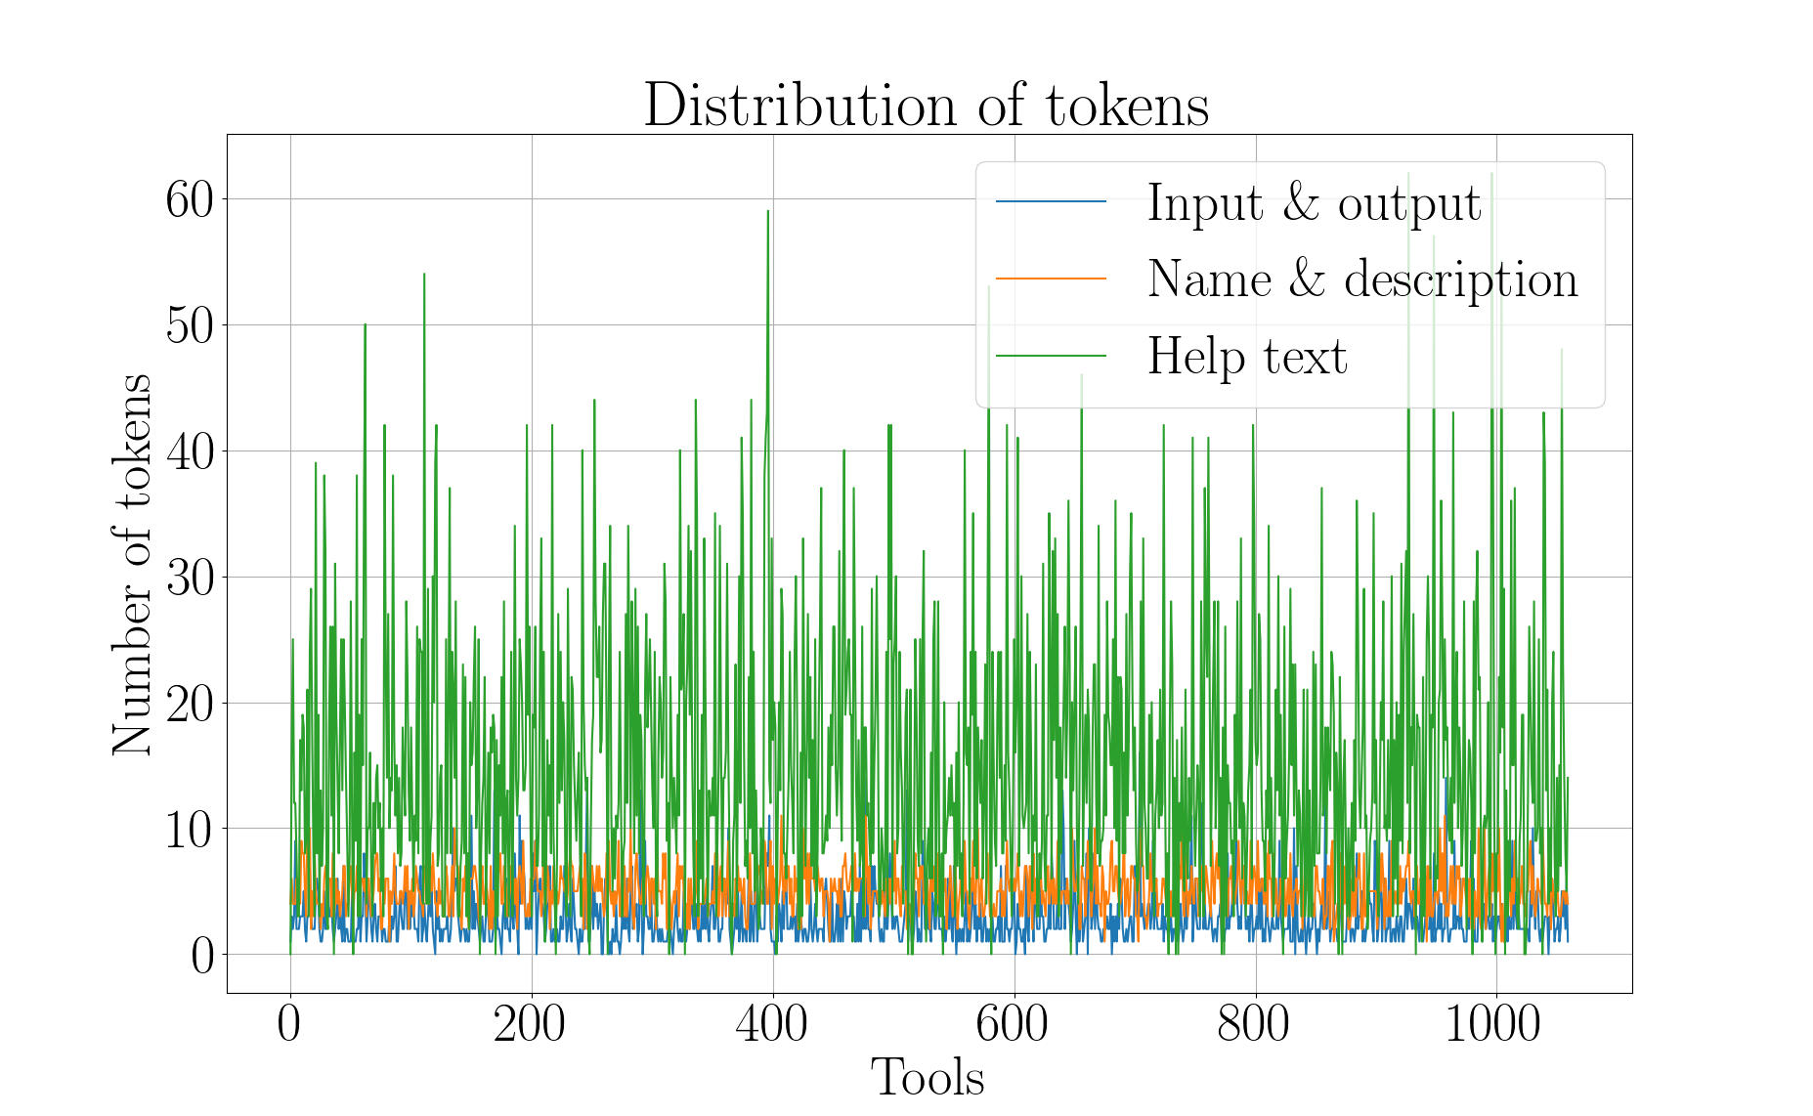
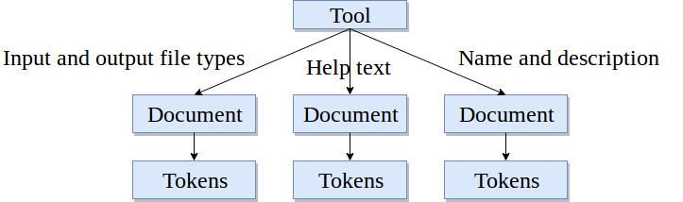
Tool, documents and tokens
Three attributes
Document - a collection of tokens

Slide 6
Paragraph (document) vector
A dense vector for each paragraph
Paragraph - a collection of tokens
Similar paragraphs, similar vectors
Encode variable length paragraphs
Each tool has three paragraphs (documents)
Paragraph vector: https://cs.stanford.edu/~quocle/paragraph_vector.pdf
Input/output file types - https://dl.acm.org/citation.cfm?id=1704810 (bestmatch25)

Slide 7
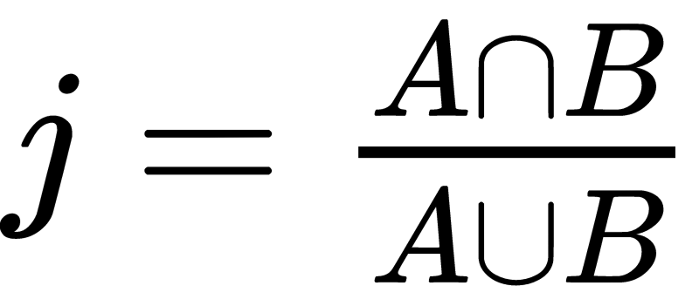
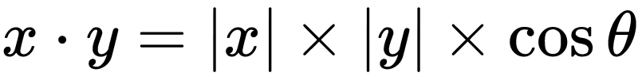
Similarity scores
Jaccard index (input and output file types)
Cosine angle (name and description and help text)
Compute similarity matrix
Three similarity matrices
Simple - average the matrices
Better - learn weights
Jaccard index: https://link.springer.com/article/10.1007/BF02365362
Cosine angle similarity: https://www.itl.nist.gov/div898/software/dataplot/refman2/auxillar/cosdist.htm

Slide 8
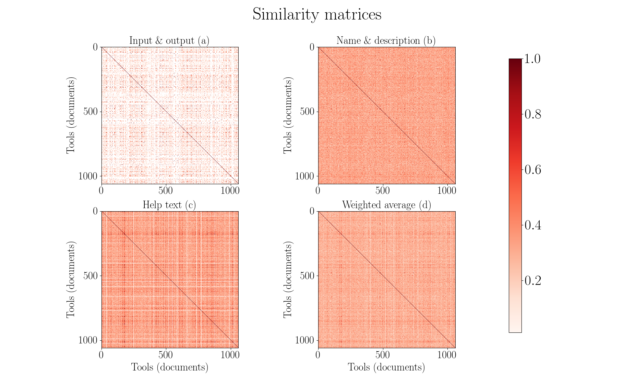

Slide 9
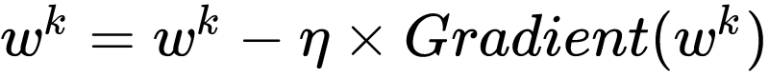
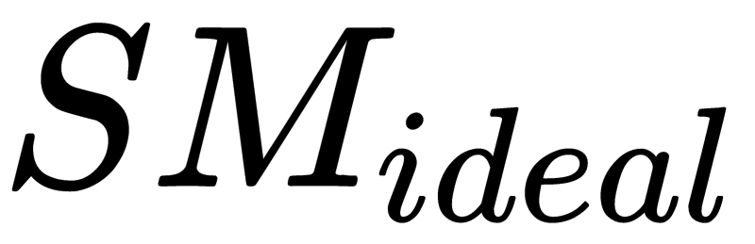
Optimisation
Gradient descent
Learn weights on similarity scores
Obtain a weighted average similarity matrix
…. (1)
…. (2)
…. (3)
is an array of 1.0
Gradient descent: https://developers.google.com/machine-learning/crash-course/reducing-loss/gradient-descent

Slide 10
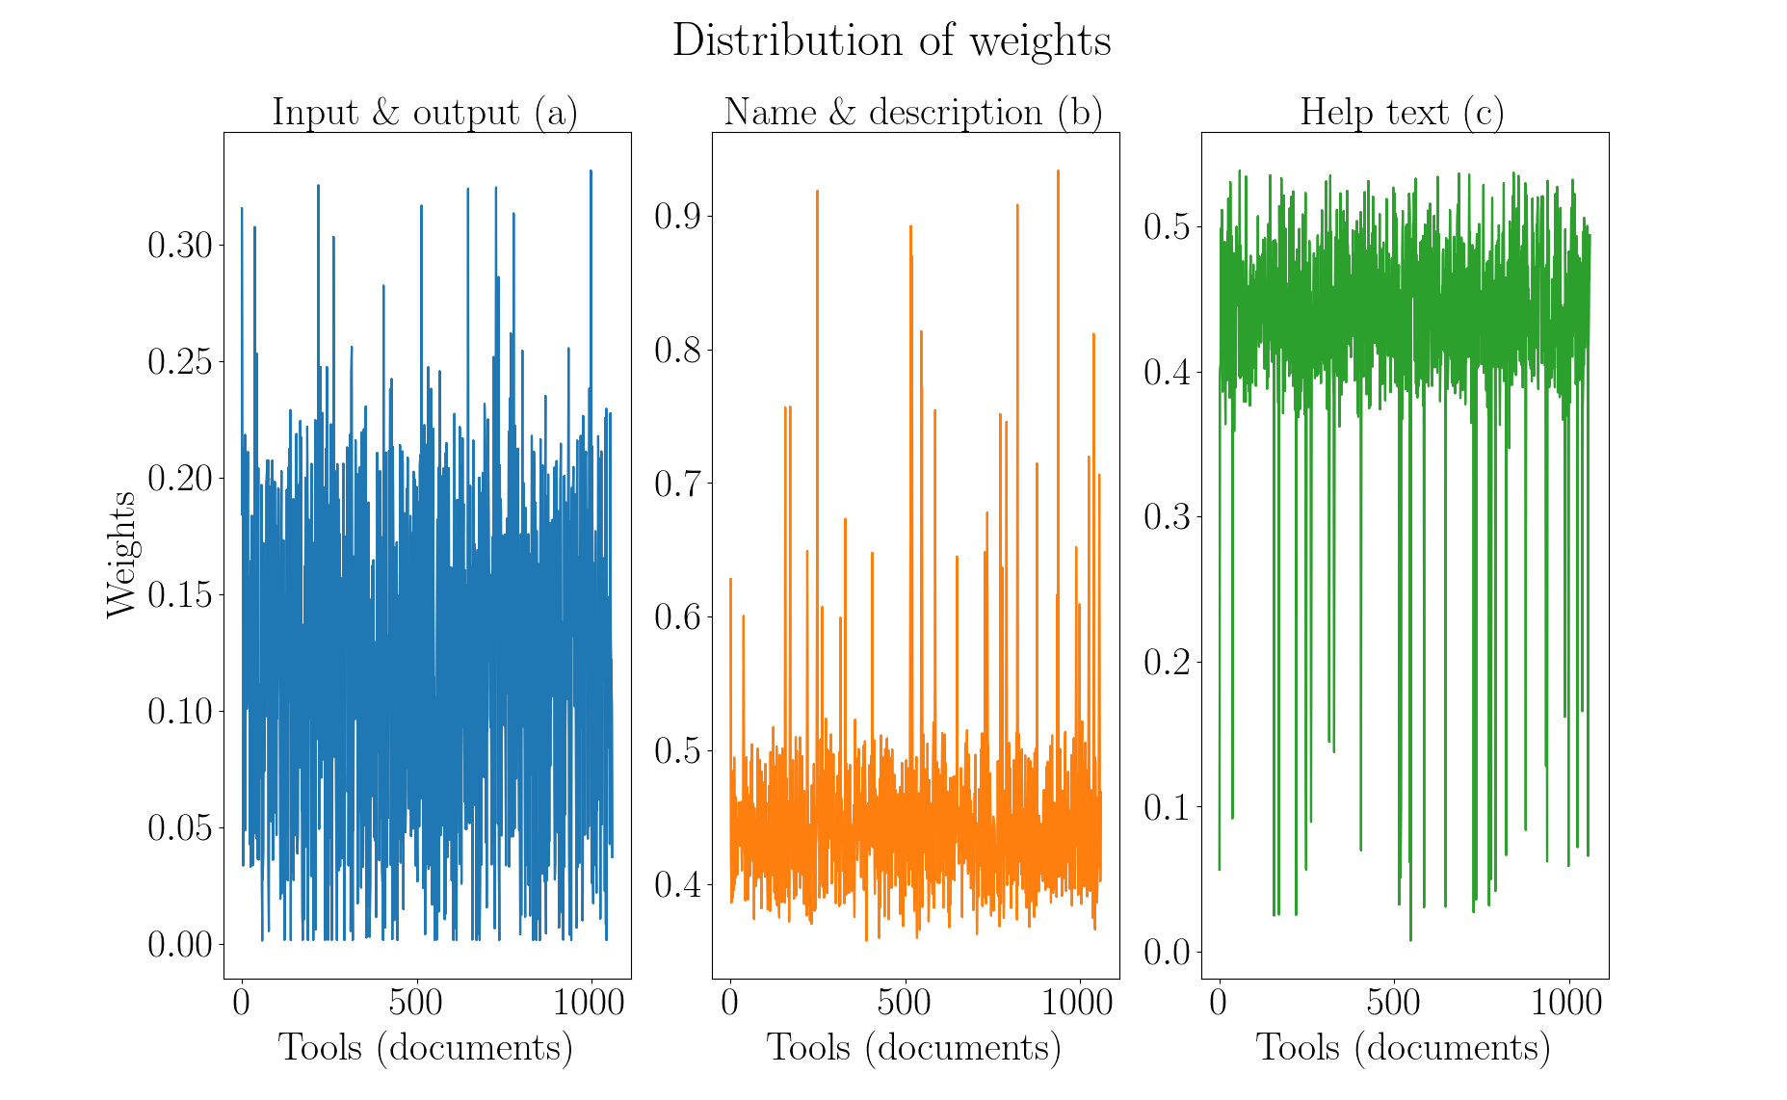

Slide 11
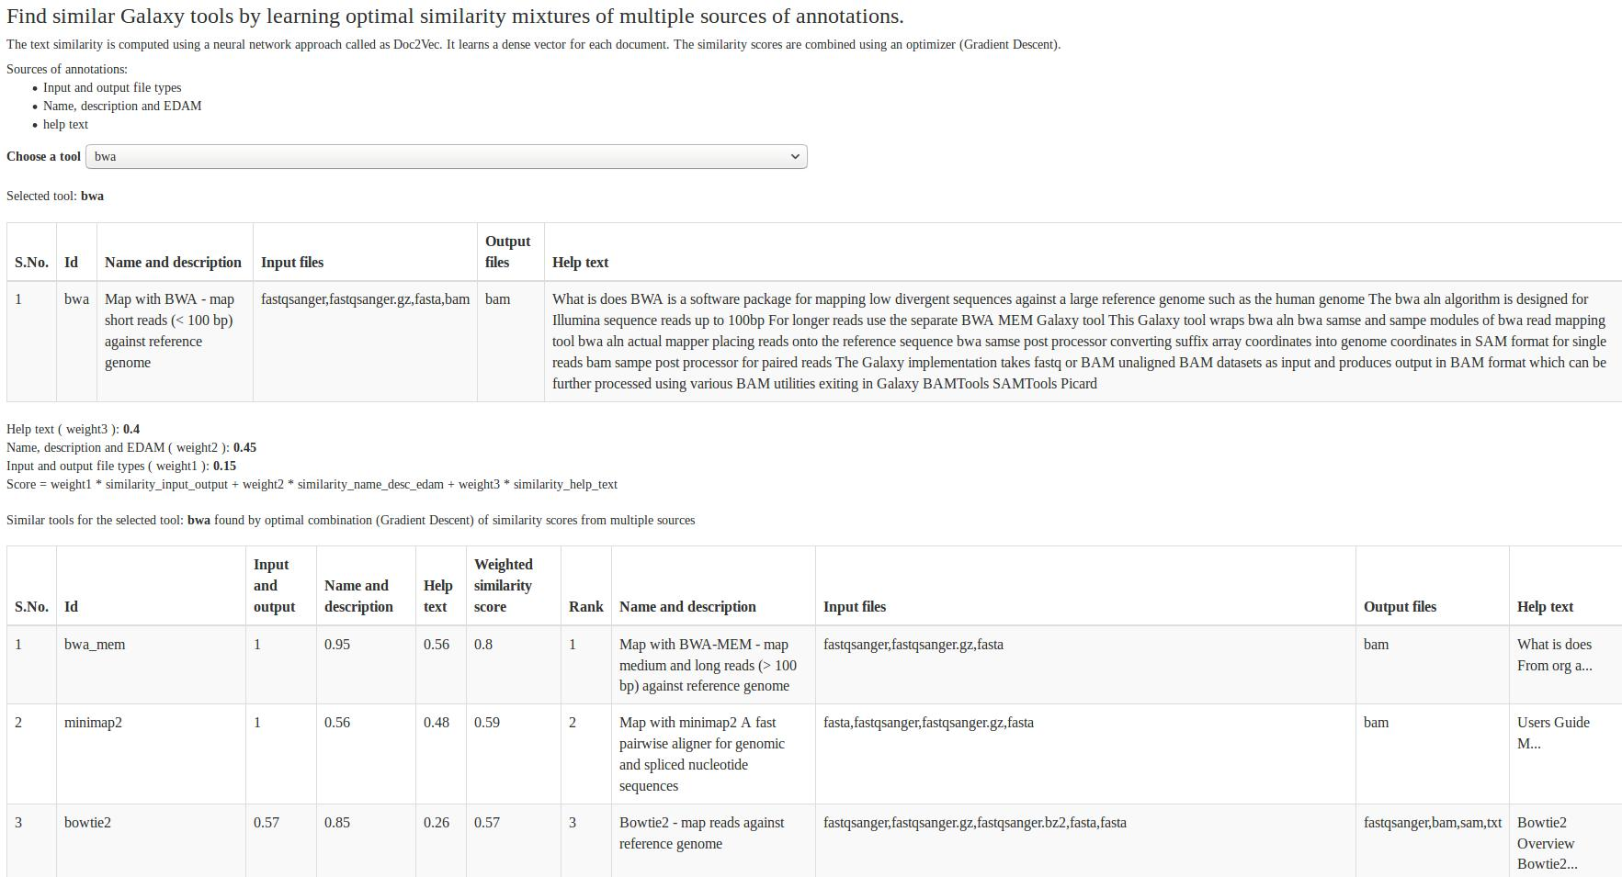
https://rawgit.com/anuprulez/similar_galaxy_tools/master/viz/similarity_viz.html

Slide 12
Summary and conclusion
Collect and clean tools metadata (~ 1,050 tools)
Learn vector for each tool
Compute and combine similarity matrices
No true similarity
Exclude low similarity values
Run analysis on larger set of tools
Compute similar tools using workflows

Slide 13
2. Predict tools in workflows
Thousands of tools
Tough to assemble workflows
Tools compatibility issues
Loss of computation time

Slide 14
Approach
Extract paths from workflows
Remove duplicate paths
Preprocess the paths
Divide into training and test sets
Classify using recurrent neural network
Compute precision

Slide 15
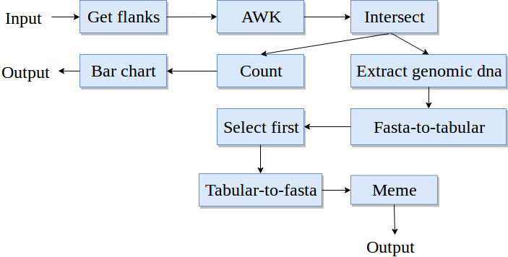
Workflows
Workflow - a directed acyclic graph
Paths in a workflow
~ 193,000 workflows
~ 900,000 paths (~ 167,000 unique)
Maximum 25 tools in a path
Directed acyclic graph: https://cran.r-project.org/web/packages/ggdag/vignettes/intro-to-dags.html
https://galaxyproject.org/learn/advanced-workflow/

Slide 16
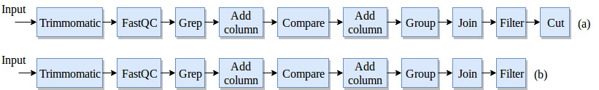
Workflow preprocessing
No decomposition
Last tool is a label

Slide 17
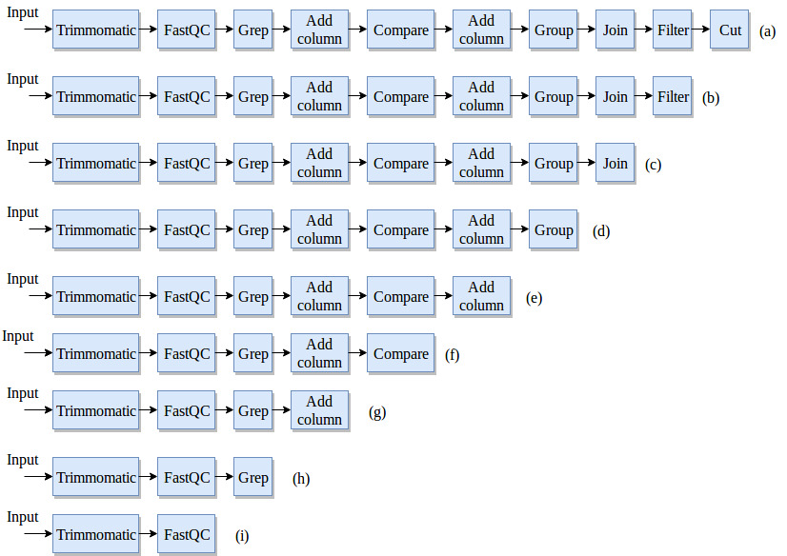
Workflow preprocessing
Decomposition
Last tool is a label

Slide 18
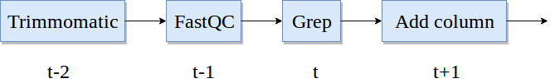
Recurrent neural network
Classifier to learn on sequential data
Multilabel, multiclass classification
Recurrent neural network - Gated recurrent units
Learn long-range dependencies
Recurrent neural network: https://arxiv.org/pdf/1412.3555.pdf
Gated recurrent units: https://arxiv.org/pdf/1412.3555v1.pdf

Slide 19
Network configuration
An embedding layer, two hidden layers and an output layer
Cross-entropy loss
Root mean square propagation (rmsprop) optimiser
Sigmoid output activation
80% training paths, 20% test paths
20% of training paths as validation paths
Cross-entropy: http://www.cse.unsw.edu.au/~billw/cs9444/crossentropy.html
RMSProp: https://www.cs.toronto.edu/~tijmen/csc321/slides/lecture_slides_lec6.pdf

Slide 20
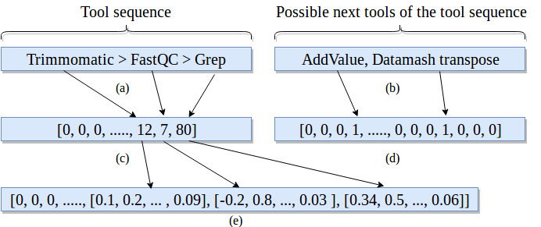
Embedding and label vectors
Dimensions:
Embedding - 512
Label vector - 1,800
Tool sequence - 25
Embedding layer: https://keras.io/layers/embeddings/

Slide 21
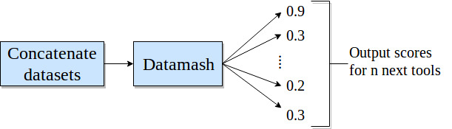
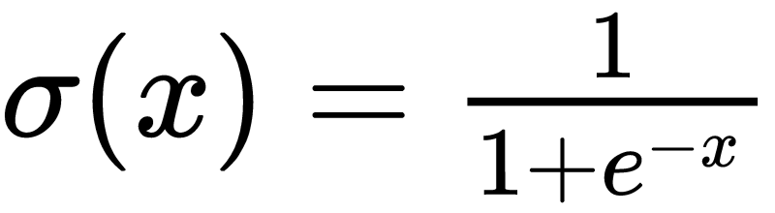
Prediction and precision
Score for each predicted tool
Sigmoid activation
Multiple possible tools for a path
Absolute precision
Compatible precision
Sigmoid: https://cs231n.github.io/neural-networks-1/

Slide 22
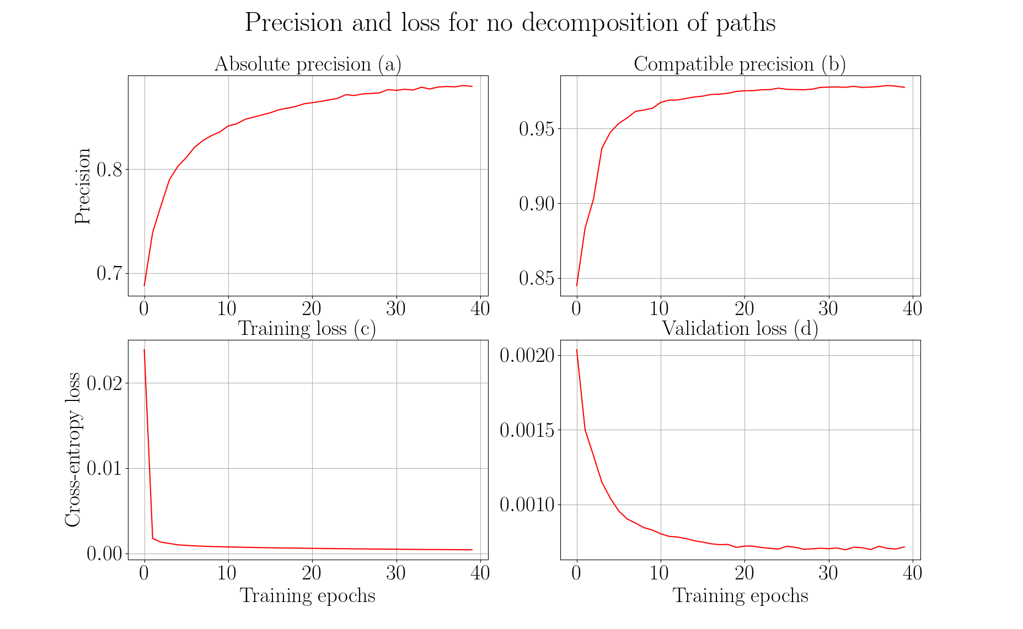

Slide 23
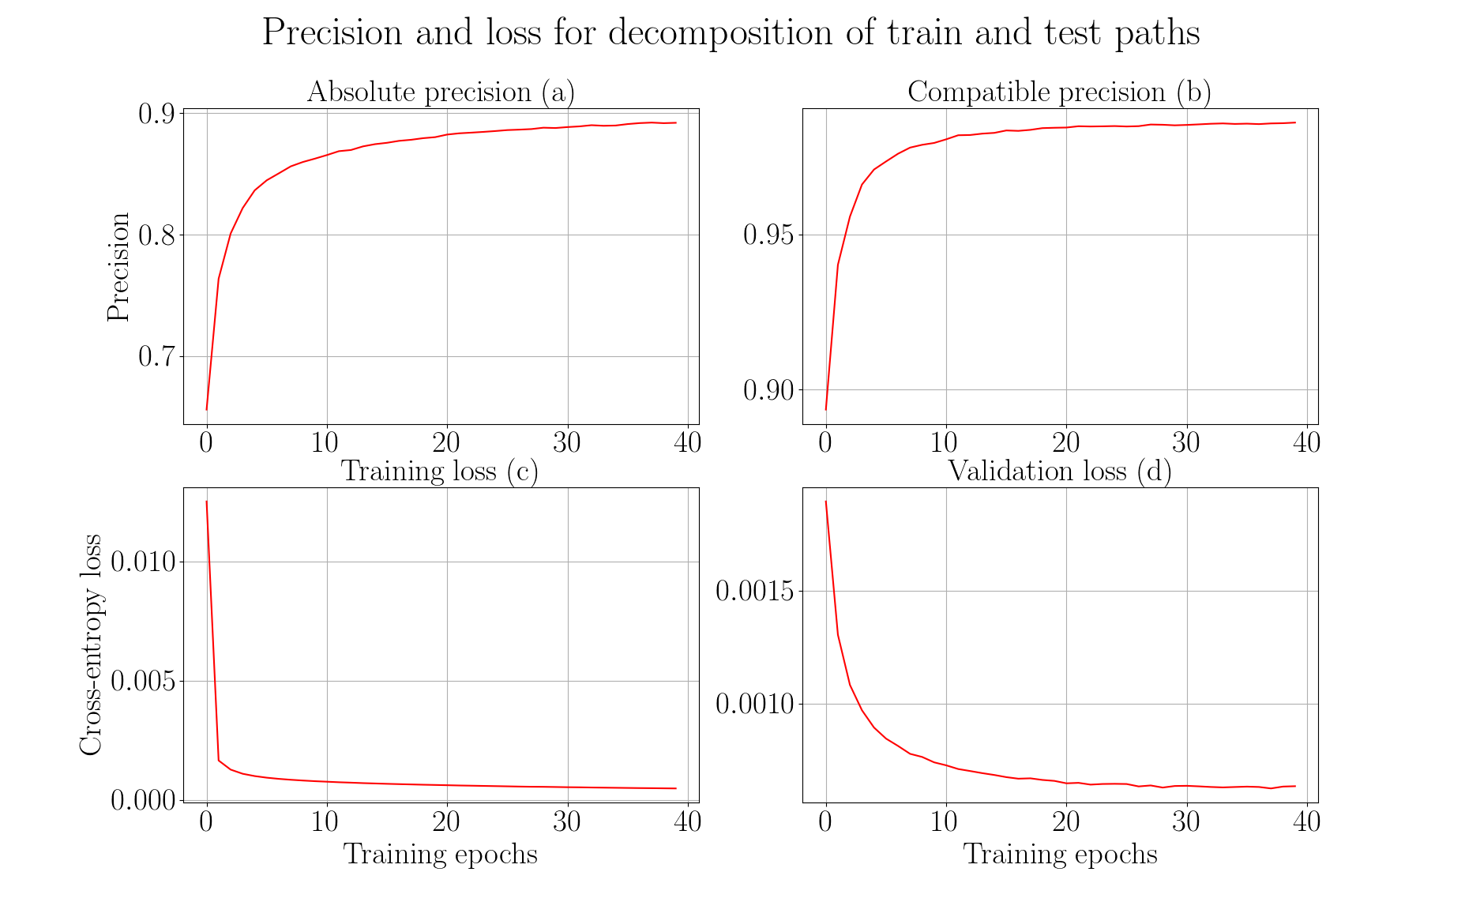

Slide 24
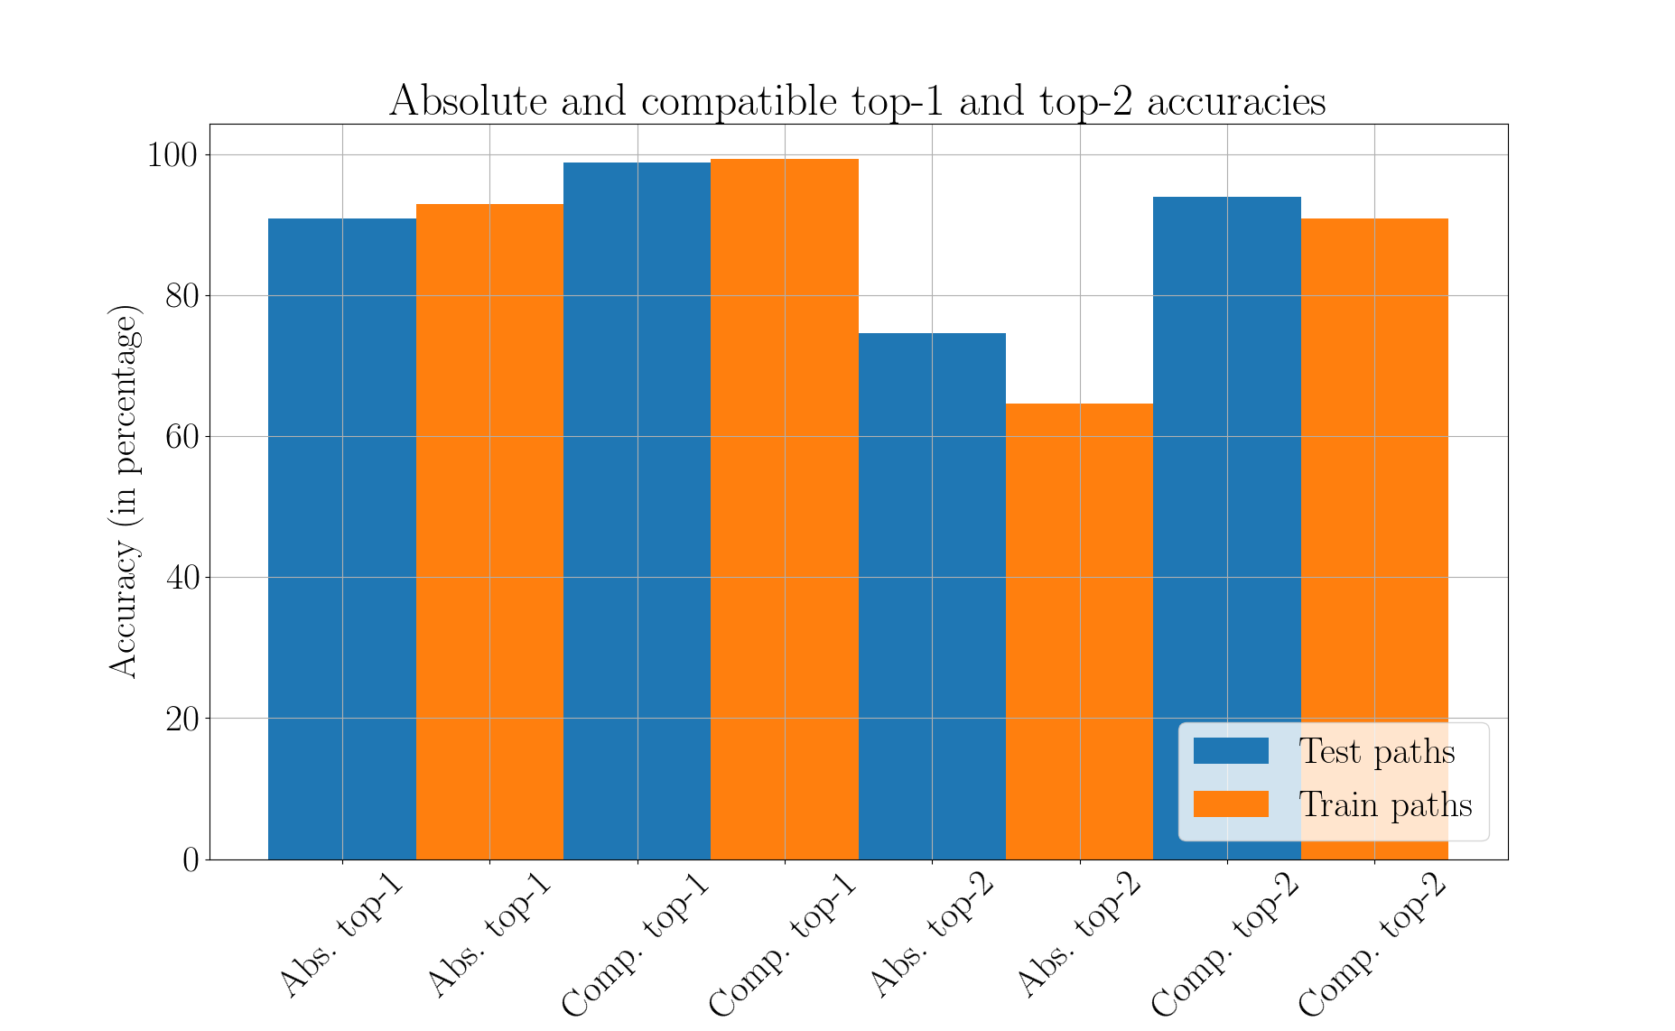

Slide 25
Summary and conclusion
Workflows - directed acyclic graphs (193,000)
Extract paths (167,000 unique) from workflows
Recurrent neural network (gated recurrent units)
Learn long-range dependencies
Multilabel, multiclass classification
No decomposition:
Absolute precision ~ 88%, compatible precision ~ 98% (~ 22 hrs)
Decomposition:
Absolute precision ~ 89%, compatible precision ~ 99% (~ 48 hrs)
More workflows, better precision
Recommendation system using similar and predicted tools

Slide 26
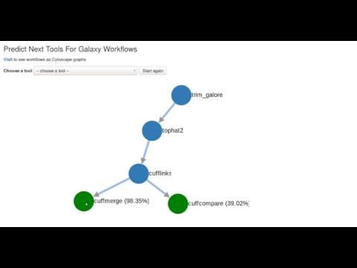

Slide 27
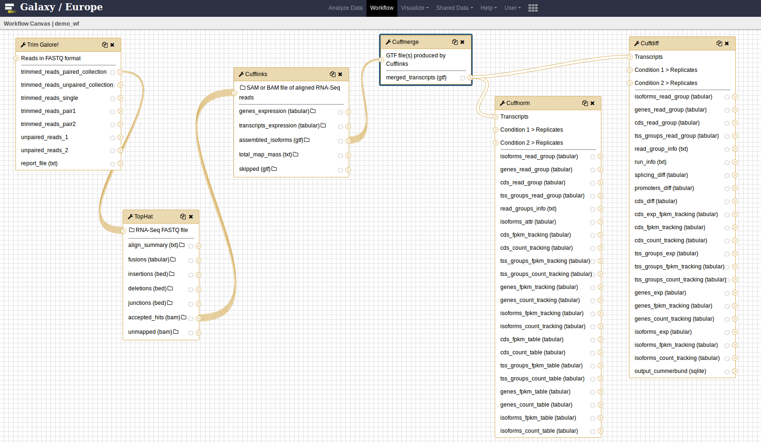

Slide 28
Future work
Restore original distribution
Decay prediction over time
Oversample
Integrate into Galaxy

Slide 29
Thank you for your attention
Questions?

Slide 30
Supplementary material

Slide 31
Stemming and stopwords
Stemming - converge all forms of a word into one basic form
“Operate, operating, operates, operation, operative, operatives, operational” into “oper” [1]
Stopwords - “a, about, above, would, could …” [2]
https://nlp.stanford.edu/IR-book/html/htmledition/stemming-and-lemmatization-1.html
https://www.ranks.nl/stopwords

Slide 32
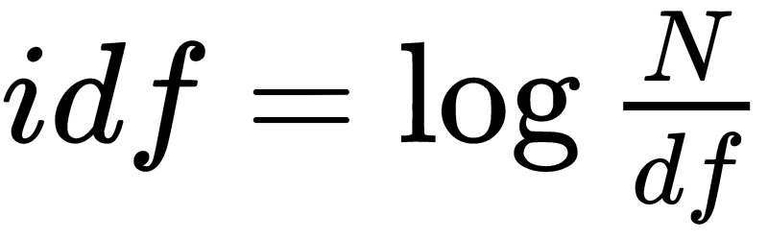
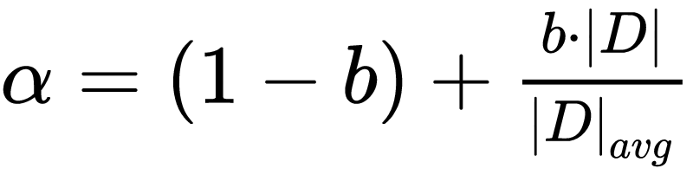
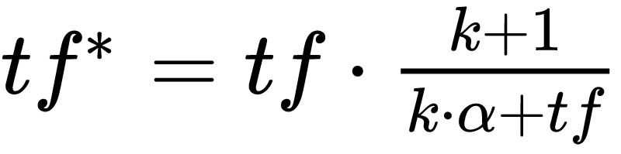
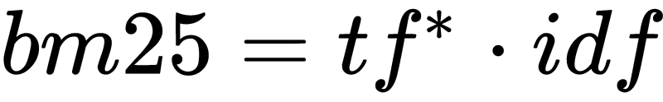
Bestmatch25 (bm25)
Token frequency (tf)
Document and inverted document frequency (idf)
https://dl.acm.org/citation.cfm?id=1704810
http://www.staff.city.ac.uk/~sb317/papers/foundations_bm25_review.pdf

Slide 33
Bestmatch25 (bm25) scores
Tools/Tokens | Regress | Linear | Gap | Mapper | Perform
LinearRegression | 5.22 | 4.1 | 0.0 | 0.0 | 3.84
LogisticRegression | 3.54 | 0.0 | 0.0 | 0.0 | 2.61
Tophat2 | 0.0 | 0.0 | 1.47 | 1.47 | 0.0
Hisat | 0.0 | 0.0 | 0.0 | 0.0 | 0.0

Slide 34
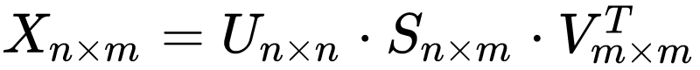
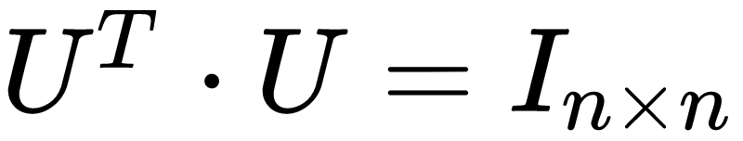
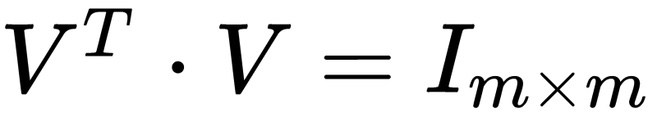
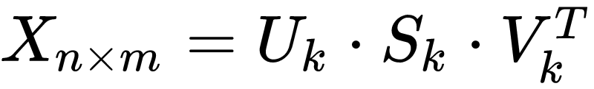
Latent Semantic Analysis
Document-token matrix (X)
Singular value decomposition
http://theory.stanford.edu/~tim/s15/l/l9.pdf

Slide 35
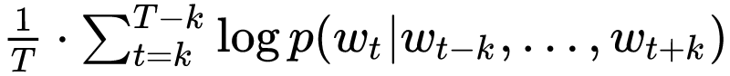
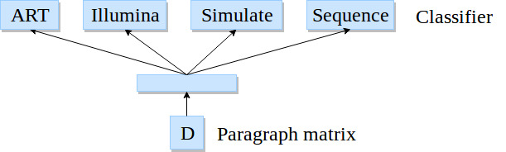
Paragraph vectors
Softmax classifier
Backpropagation
Stochastic gradient descent
Gensim*
800 iterations, 10 epochs
*https://radimrehurek.com/gensim/models/doc2vec.html
Image adapted from: https://cs.stanford.edu/~quocle/paragraph_vector.pdf

Slide 36
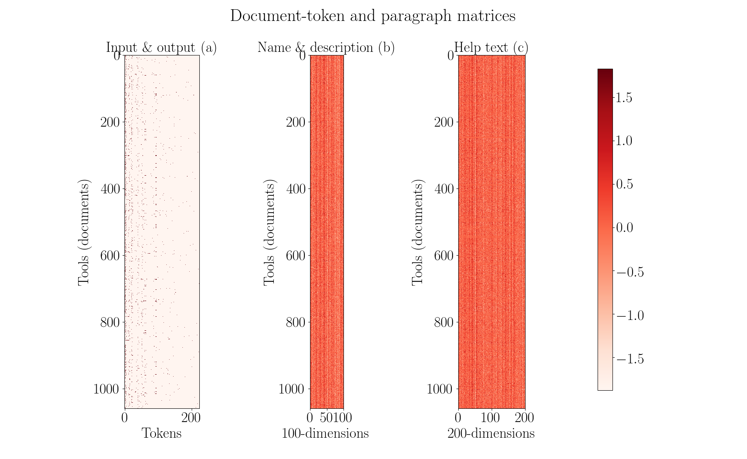

Slide 37
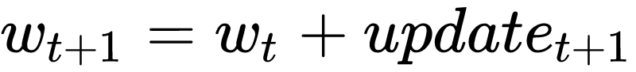
Optimisation
Gradient descent
Mean squared error
Initial learning rate - 0.05
Decay learning rate
Nesterov’s accelerated gradient
https://arxiv.org/pdf/1609.04747.pdf

Slide 38
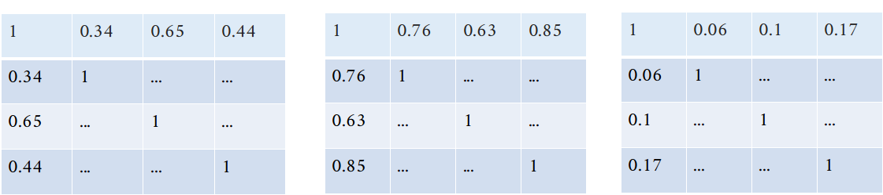
Optimisation

Slide 39
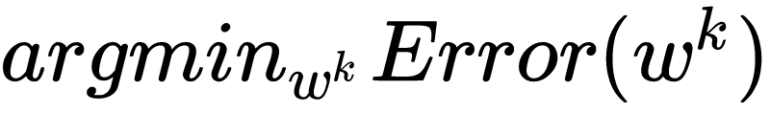
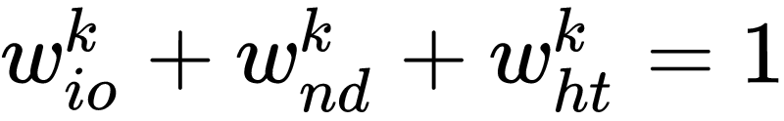
Optimisation

Slide 40
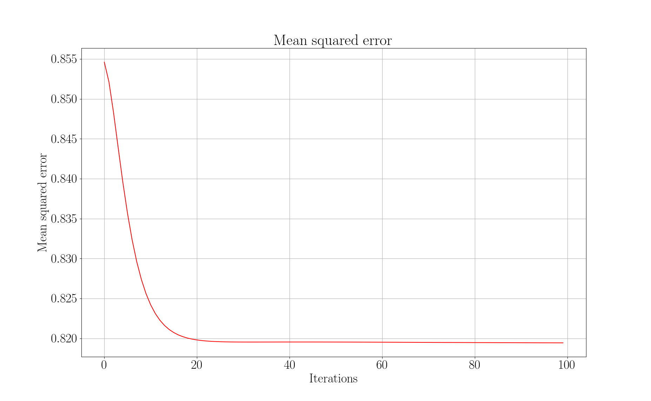

Slide 41
Visualisers
Paragraph vectors
Latent Semantic Analysis (5% of full-rank)

Slide 42
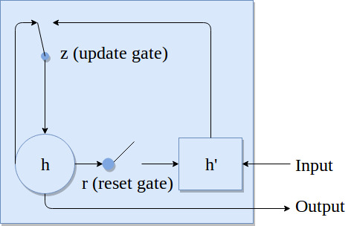
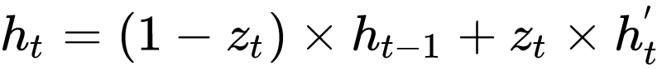
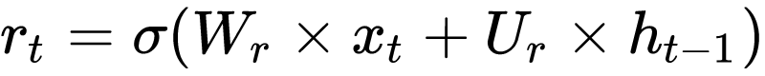
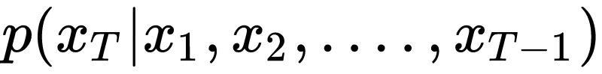
Recurrent neural network
RNN: https://arxiv.org/pdf/1412.3555.pdf

Slide 43
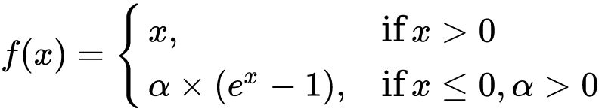
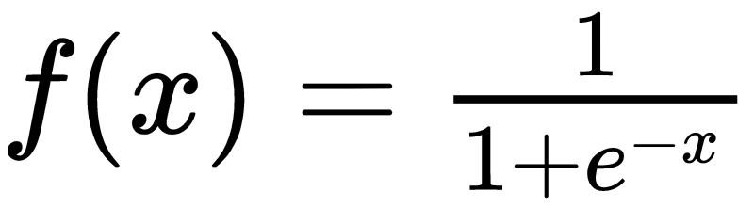
Recurrent neural network
One embedding layer, two hidden layer and one output layer
Recurrent layer activation - exponential linear unit
Output activation is sigmoid
Exponential linear units: https://arxiv.org/pdf/1511.07289.pdf

Slide 44
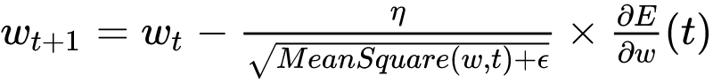
Recurrent neural network
Optimiser - Root mean square propagation (rmsprop)
Binary cross-entropy loss
RMSProp: https://arxiv.org/pdf/1609.04747.pdf
Binary cross-entropy: https://www.tensorflow.org/api_docs/python/tf/keras/losses/binary_crossentropy

Slide 45
Paths statistics
No decomposition:
Total paths (111,386), train paths (89,109) and test paths (22,277).
Decomposition:
Total paths (210,983), train paths (168,787) and test paths (42,196).

Slide 46
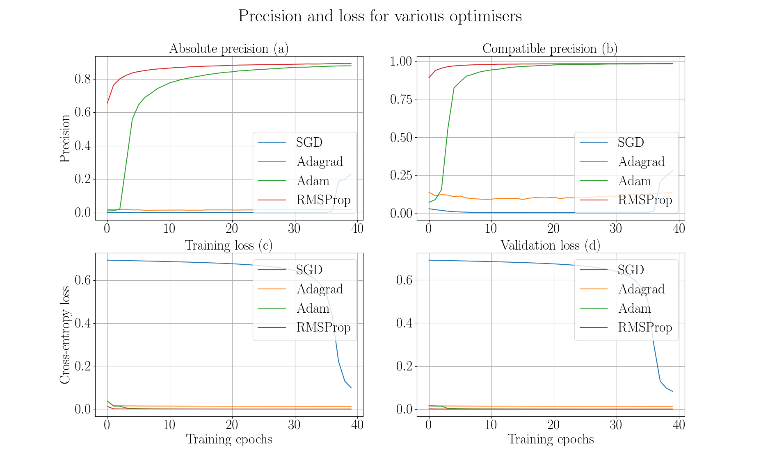

Slide 47
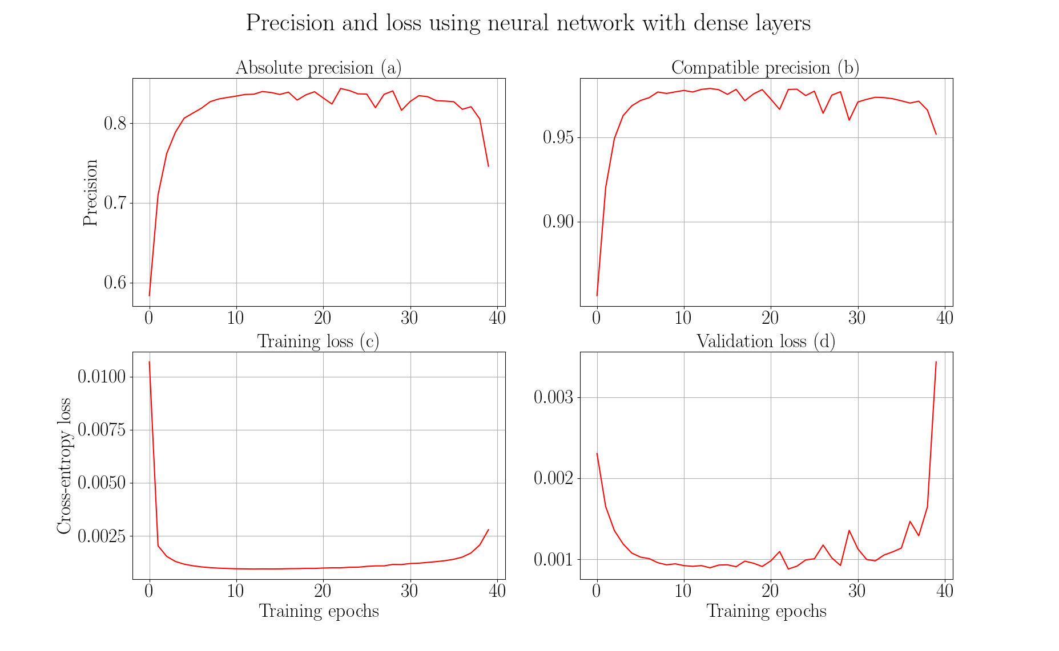

Slide 48
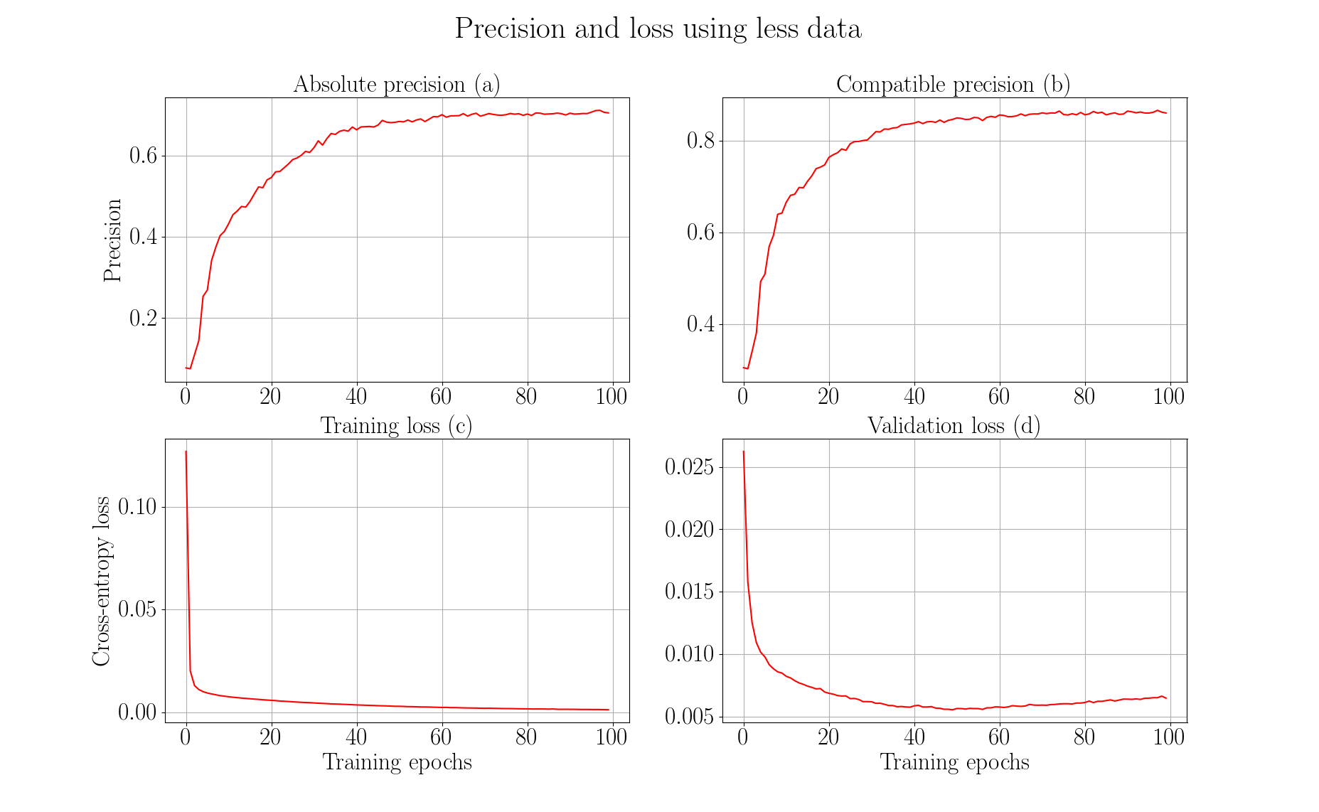

Slide 49
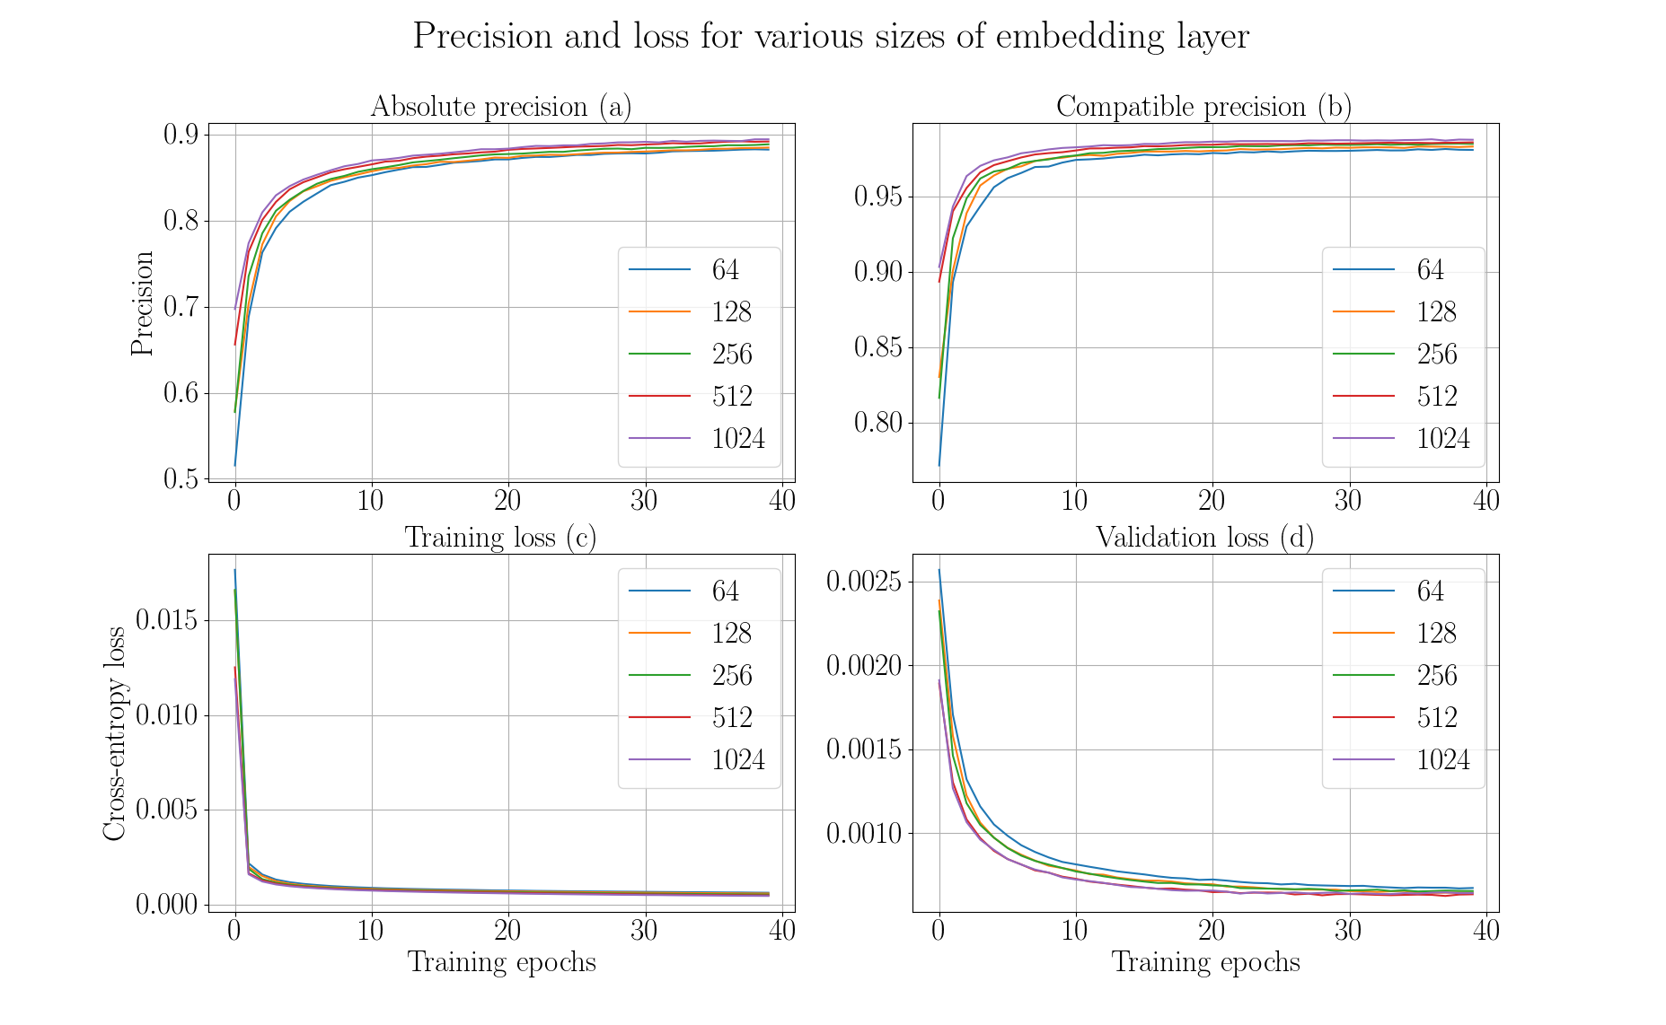

Slide 50


Slide 51


Slide 52


Slide 53


Slide 54


Slide 55


Slide 56


Slide 57


Slide 58

Higher order dependency
Not dependent only on immediate parent
Dependent on all previous tools
Higher order dependency: https://arxiv.org/pdf/1506.06268.pdf
https://arxiv.org/pdf/1508.03113.pdf

Slide 59
Bayesian network
Explain workflows
Predict missing nodes
Compute joint and conditional probabilities
High computational cost with large number of nodes
Prediction by probabilistic network is a hard problem
https://www.microsoft.com/en-us/research/uploads/prod/2004/01/Large-Sample-Learning-of-Bayesian-Networks-is-NP-Hard.pdf
https://www.sciencedirect.com/science/article/pii/000437029090060D

Slide 60
Hidden markov models
Transition and prior probabilities
Transition matrix is large
Current state depends only on previous state (first-order)
Higher number of parameters
Higher order markov models
https://arxiv.org/pdf/q-bio/0505002.pdf
https://pdfs.semanticscholar.org/8463/dfee2b46fa813069029149e8e80cec95659f.pdf
http://mlg.eng.cam.ac.uk/zoubin/papers/ijprai.pdf

